Slide 1

TransArt -A Multimodal Application Nivetha B AA.SC.P2MCA24074078

Slide 2
TransArt: A Multimodal AI Application
TransArt: A Multimodal AIApplication TransArt seamlessly transcribes audio,translates it into multiple languages, and generates stunning visuals based on the content.

Slide 3

KEY FEATURES
Audio Transcription
Language Translation
Prompt to image
AI Image Generation and UserFriendly Interface

Slide 4
Continue…
Language Translation
Seamlessly translates text between multiple languages, enabling broader communication
Audio Transcription
Converts speech to text in real-time with high accuracy.
AI Image Generation and UserFriendly Interface
Generates stunning visuals based on text prompts or translations and Intuitive design powered by Gradio for easy use across all features.
Prompt to image
Engages users in natural language conversations, providing relevant responses and images.

Slide 5
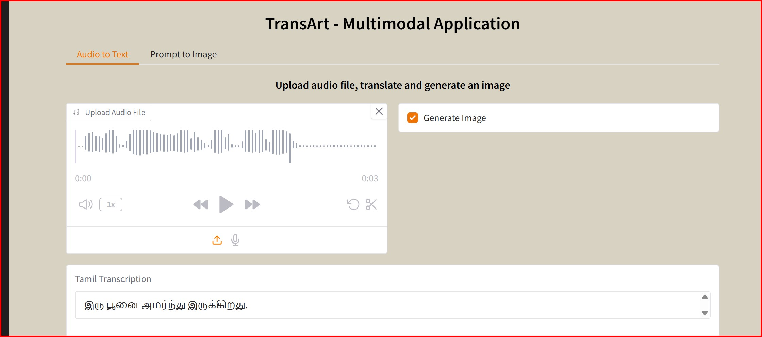
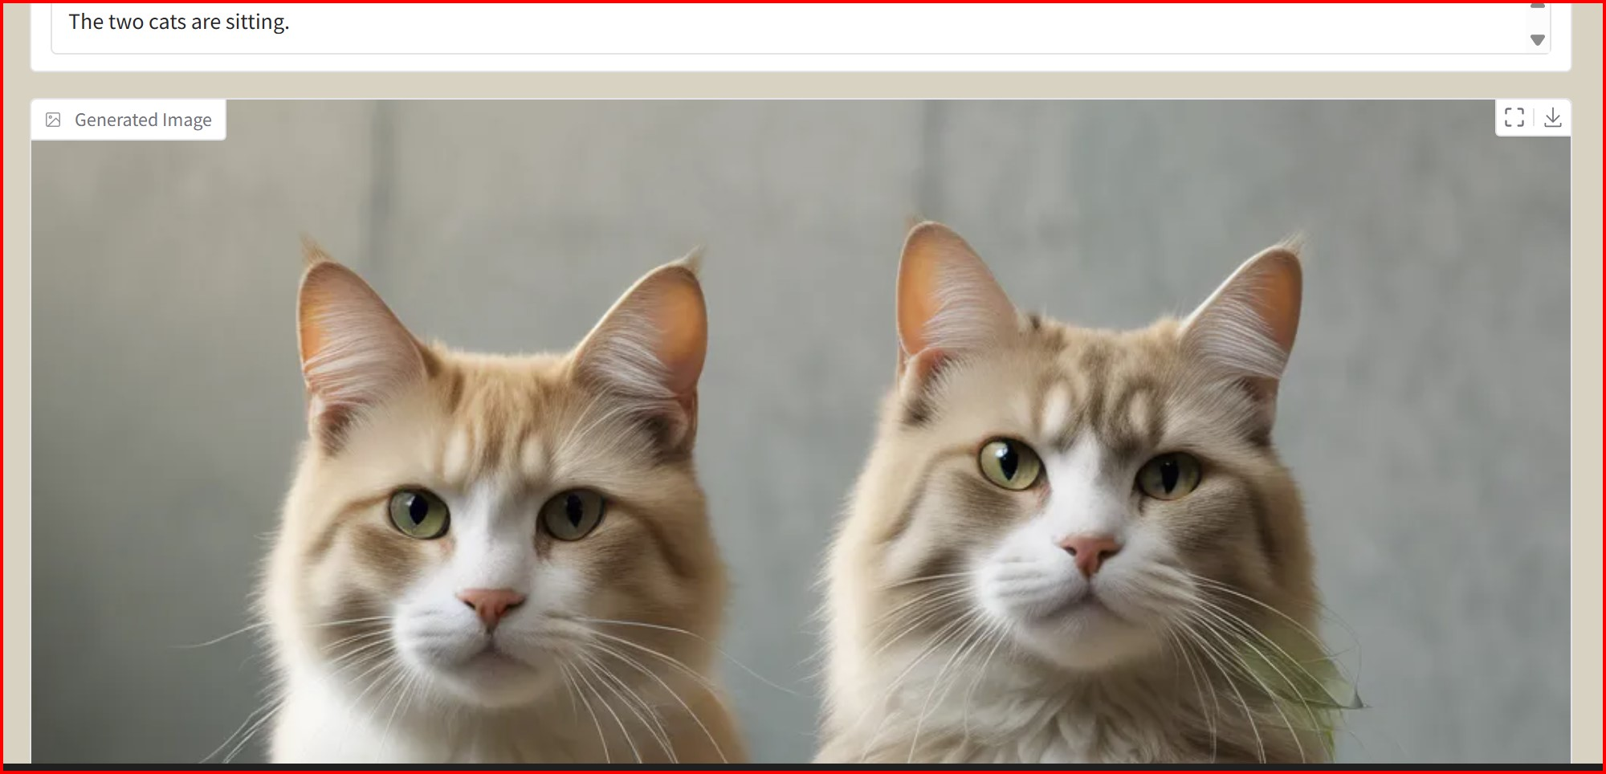
TransArt: A Multimodal Application

Slide 6
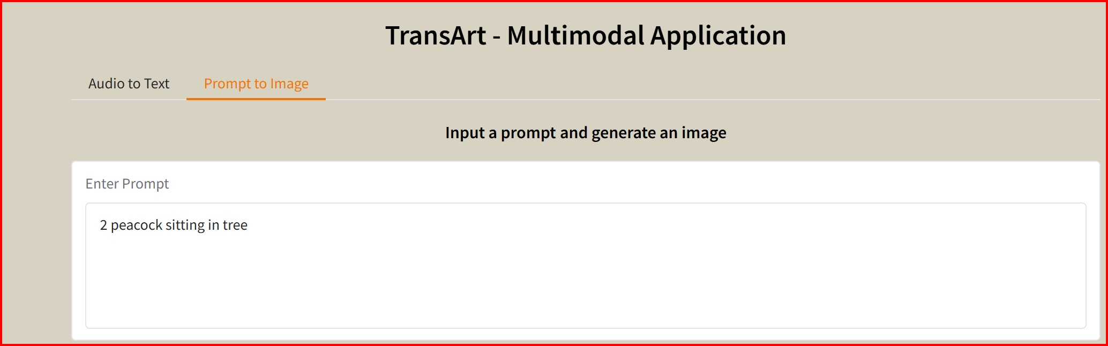

TransArt: A Multimodal Application

Slide 7
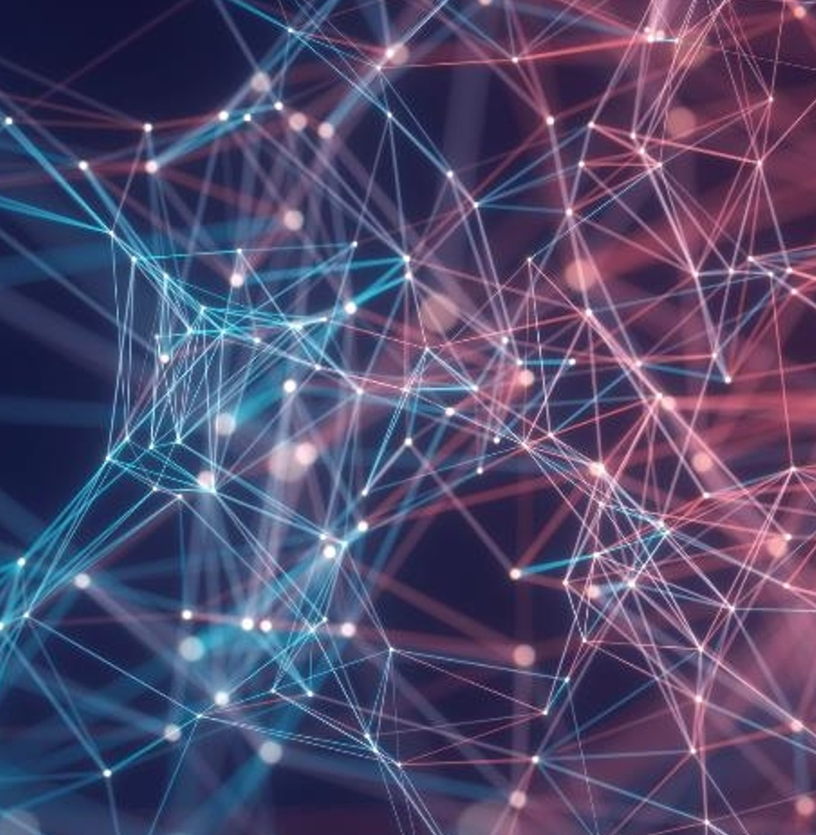
Question
Thank you

